Slide 1
컴퓨터네트워크
20174627 김혜진

Slide 2
01. EstimatedRTT
(왕복시간 예측 값)
02. DevRTT
(여유값)
03. TimeoutInterval
(타임 아웃 주기)

Slide 3
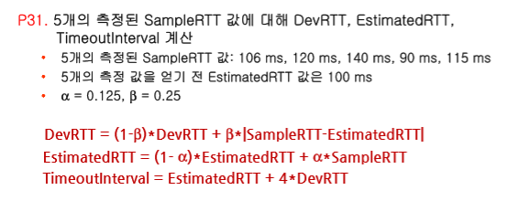
문제

Slide 4
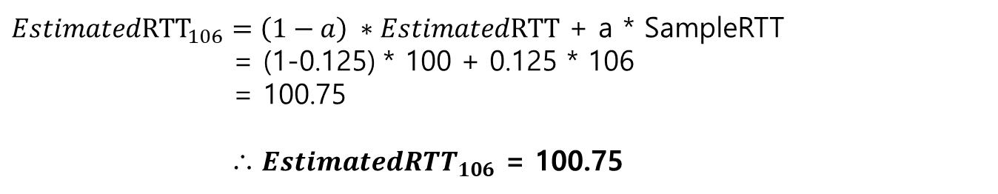
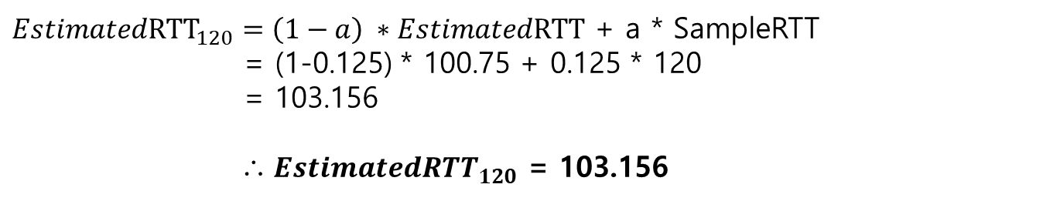
EstimatedRTT
SampleRTT = 106ms, 120ms, 140ms, 90ms, 115ms
EstimatedRTT = 100ms
${EstimatedRTT}_{106}=\left(1−a\right) ∗EstimatedRTT$ + a * SampleRTT
= (1-0.125) * 100 + 0.125 * 106
= 100.75
∴ ${EstimatedRTT}_{106}$ = 100.75
${EstimatedRTT}_{120}=\left(1−a\right) ∗EstimatedRTT$ + a * SampleRTT
= (1-0.125) * 100.75 + 0.125 * 120
= 103.156
∴ ${EstimatedRTT}_{120}$ = 103.156

Slide 5
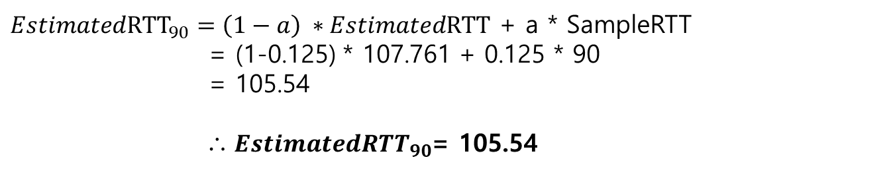
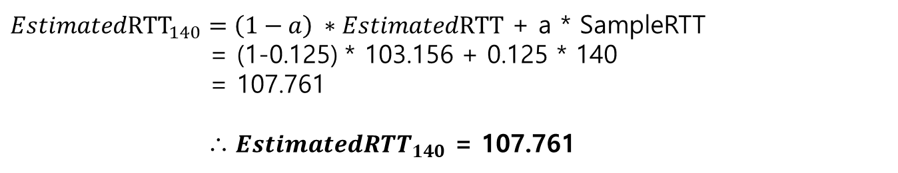
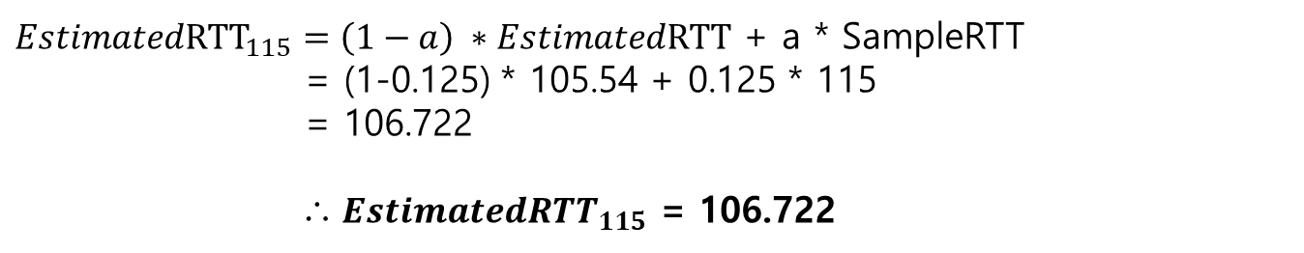
EstimatedRTT
${EstimatedRTT}_{140}=\left(1−a\right) ∗EstimatedRTT$ + a * SampleRTT
= (1-0.125) * 103.156 + 0.125 * 140
= 107.761
∴ ${EstimatedRTT}_{140}$ = 107.761
${EstimatedRTT}_{90}=\left(1−a\right) ∗EstimatedRTT$ + a * SampleRTT
= (1-0.125) * 107.761 + 0.125 * 90
= 105.54
∴ ${EstimatedRTT}_{90}$= 105.54
${EstimatedRTT}_{115}=\left(1−a\right) ∗EstimatedRTT$ + a * SampleRTT
= (1-0.125) * 105.54 + 0.125 * 115
= 106.722
∴ ${EstimatedRTT}_{115}$ = 106.722

Slide 6
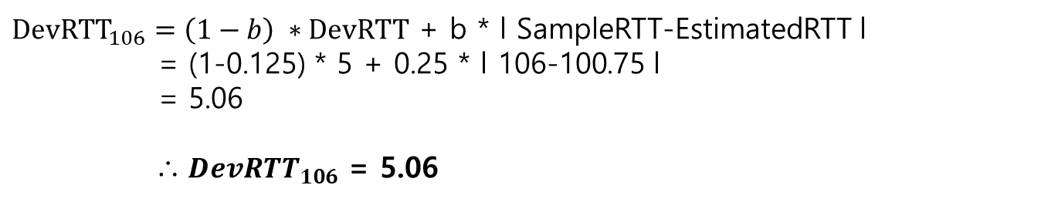
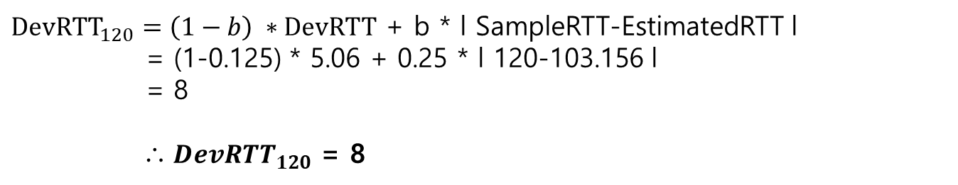
DevRTT
DevRTT = 5ms
${DevRTT}_{106}=\left(1−b\right) ∗DevRTT$ + b * l SampleRTT-EstimatedRTT l
= (1-0.125) * 5 + 0.25 * l 106-100.75 l
= 5.06
∴ ${DevRTT}_{106}$ = 5.06
${DevRTT}_{120}=\left(1−b\right) ∗DevRTT$ + b * l SampleRTT-EstimatedRTT l
= (1-0.125) * 5.06 + 0.25 * l 120-103.156 l
= 8
∴ ${DevRTT}_{120}$ = 8

Slide 7
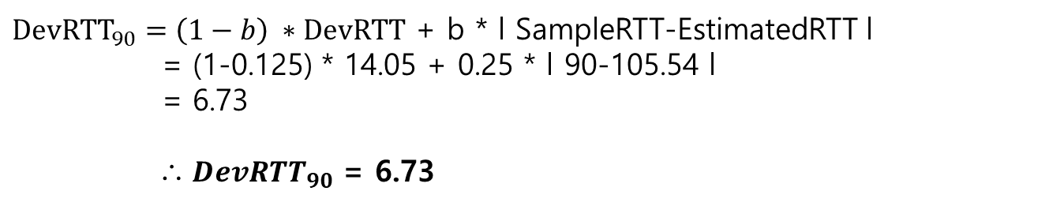
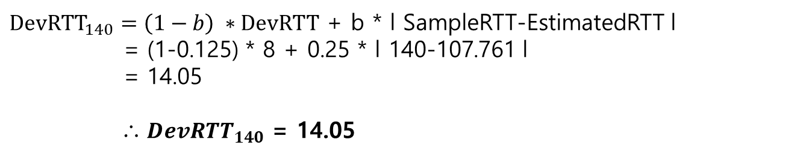
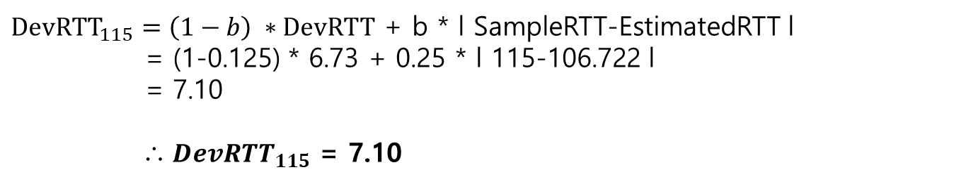
DevRTT
${DevRTT}_{140}=\left(1−b\right) ∗DevRTT$ + b * l SampleRTT-EstimatedRTT l
= (1-0.125) * 8 + 0.25 * l 140-107.761 l
= 14.05
∴ ${DevRTT}_{140}$ = 14.05
${DevRTT}_{90}=\left(1−b\right) ∗DevRTT$ + b * l SampleRTT-EstimatedRTT l
= (1-0.125) * 14.05 + 0.25 * l 90-105.54 l
= 6.73
∴ ${DevRTT}_{90}$ = 6.73
${DevRTT}_{115}=\left(1−b\right) ∗DevRTT$ + b * l SampleRTT-EstimatedRTT l
= (1-0.125) * 6.73 + 0.25 * l 115-106.722 l
= 7.10
∴ ${DevRTT}_{115}$ = 7.10

Slide 8
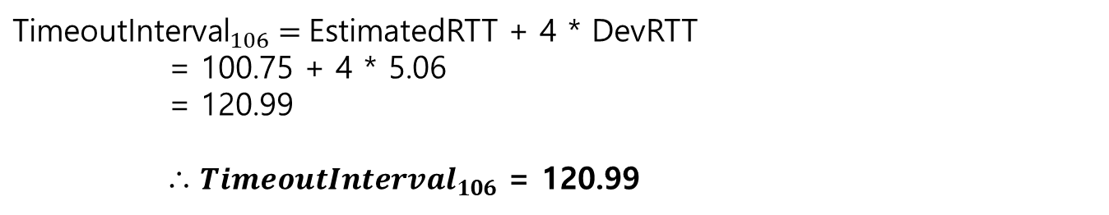
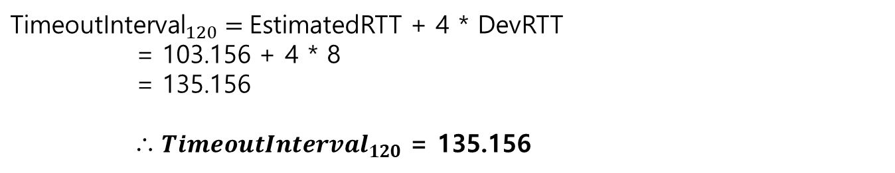
TimeoutInterval
${\text{TimeoutInterval}}_{106}=$EstimatedRTT + 4 * DevRTT
= 100.75 + 4 * 5.06
= 120.99
∴ ${TimeoutInterval}_{106}$ = 120.99
${\text{TimeoutInterval}}_{120}=$EstimatedRTT + 4 * DevRTT
= 103.156 + 4 * 8
= 135.156
∴ ${TimeoutInterval}_{120}$ = 135.156

Slide 9
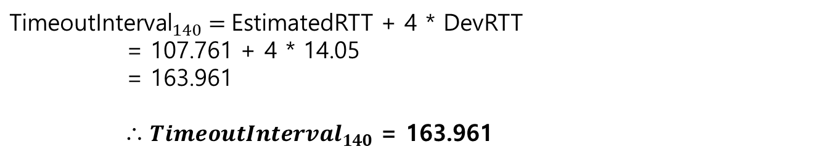
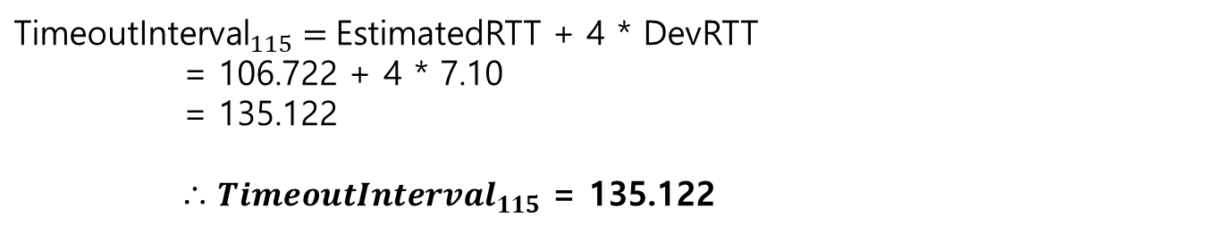
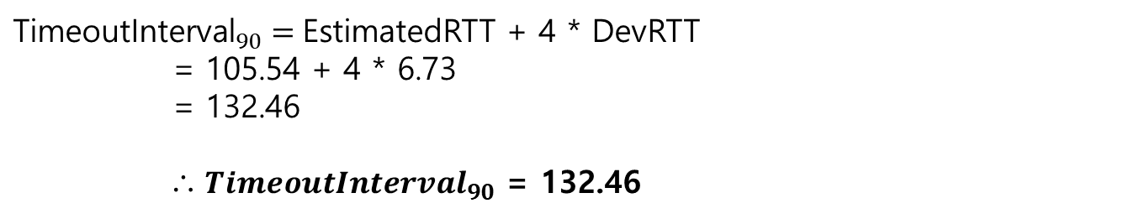
TimeoutInterval
${\text{TimeoutInterval}}_{140}=$EstimatedRTT + 4 * DevRTT
= 107.761 + 4 * 14.05
= 163.961
∴ ${TimeoutInterval}_{140}$ = 163.961
${\text{TimeoutInterval}}_{90}=$EstimatedRTT + 4 * DevRTT
= 105.54 + 4 * 6.73
= 132.46
∴ ${TimeoutInterval}_{90}$ = 132.46
${\text{TimeoutInterval}}_{115}=$EstimatedRTT + 4 * DevRTT
= 106.722 + 4 * 7.10
= 135.122
∴ ${TimeoutInterval}_{115}$ = 135.122

